Slide 1
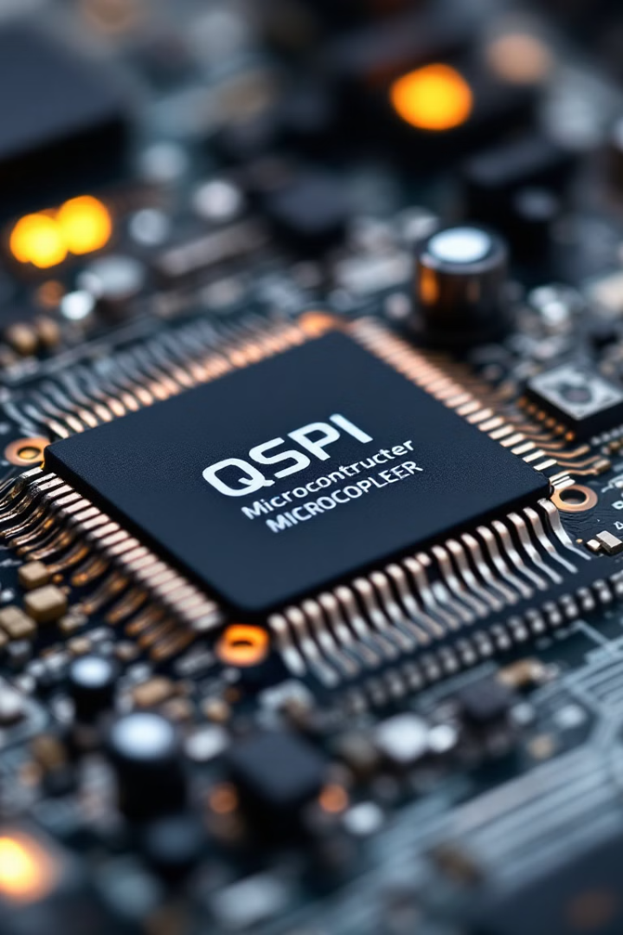
QSPI (Quad Serial Peripheral Interface) Protocol
QSPI (Quad Serial Peripheral Interface) is an enhanced version of the SPI protocol, designed for high-speed communication in embedded systems.
Uses 4 data lines (vs. SPI's 1–2 lines) to achieve quadrupled throughput.
Primary Use Case: High-speed interfacing with flash memory (e.g., NOR/NAND flash) and peripherals requiring fast data transfer.

Slide 2
QSPI vs. SPI: Key Differences
Feature
SPI
QSPI
Data Lines
1 (MOSI/MISO)
4 (IO0–IO3)
Throughput
Lower (1 bit/clock)
Higher (4 bits/clock)
Modes
Single/Dual
Single/Dual/Quad/Octal
Address/Data Phases
Fixed
Configurable (1/2/4 lines)
Applications
Sensors, EEPROMs
Flash memory, XIP execution

Slide 3
Interface Signals
SCLK (Serial Clock)
CS# (Chip Select)
IO0–IO3
Master-generated clock signal.
Activates the target slave device.
Bidirectional data lines (replace MOSI/MISO).
IO0
IO1
IO2/IO3
Also acts as MOSI in SPI mode.
Also acts as MISO in SPI mode.
Optional for WP# (Write Protect) and HOLD# functions in legacy modes.
Optional Pins:
WP# (Write Protect)
HOLD#
Protects memory regions.
Pauses communication without deselecting the device.

Slide 4
Modes of Operation
1
2
3
Standard SPI Mode
Dual SPI (2 I/O)
Quad SPI (4 I/O)
Backward-compatible with SPI (uses IO0 and IO1).
Transmits data over 2 lines (e.g., IO0 and IO1).
Uses all 4 data lines for address/data phases.
4
QPI (Quad Peripheral Interface)
Commands, addresses, and data all use 4 lines (full Quad mode).
5. Octal SPI: Extends to 8 data lines for ultra-high speed (less common).

Slide 5
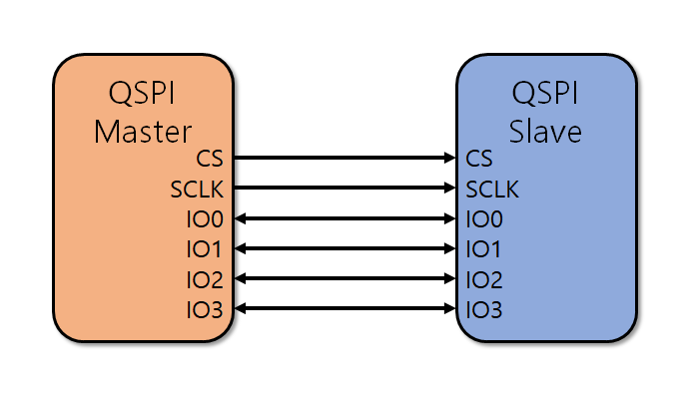
QSPI Architecture
QSPI follows a Master-Slave architecture, where a single master device (typically a microcontroller or processor) controls one or more slave devices (such as flash memory or sensors). Similar to SPI, it uses Clock (SCK), Chip Select (CS), Master Output Slave Input (MOSI), and Master Input Slave Output (MISO) lines, but QSPI enhances this by introducing four data lines (IO0 - IO3), allowing quad-bit parallel communication instead of just serial transmission. The master initiates communication by pulling the CS line low and sending commands over the data lines. Unlike standard SPI, QSPI can operate in multiple modes, including Single, Dual, and Quad modes, where the number of active data lines varies to optimize speed and efficiency. This architecture significantly boosts data throughput while maintaining synchronization between the master and slave devices.

Slide 6





QSPI Applications
Embedded Systems
IoT Devices
Fast booting and execution of firmware from external NOR flash memory, as seen in microcontrollers like STM32, ESP32, and Nordic nRF52840.
Storing firmware and sensor data efficiently.
Multimedia Applications
Automotive Industry
Digital cameras, video players, and OLED/TFT displays rely on QSPI for rapid data retrieval and image processing.
Used for navigation systems, infotainment units, and ECU firmware storage.
QSPI is also essential in industrial automation, portable storage devices, networking equipment, medical devices, and security and image processing applications. Leading semiconductor companies like Winbond, Macronix, Microchip, Infineon, and Cypress manufacture QSPI-based flash memory solutions.

Slide 7



Advantages
High Speed
1
4x faster than SPI.
Low Pin Count
2
Fewer pins than parallel interfaces.
Flexibility
3
Configurable modes for speed/compatibility trade-offs.

Slide 8
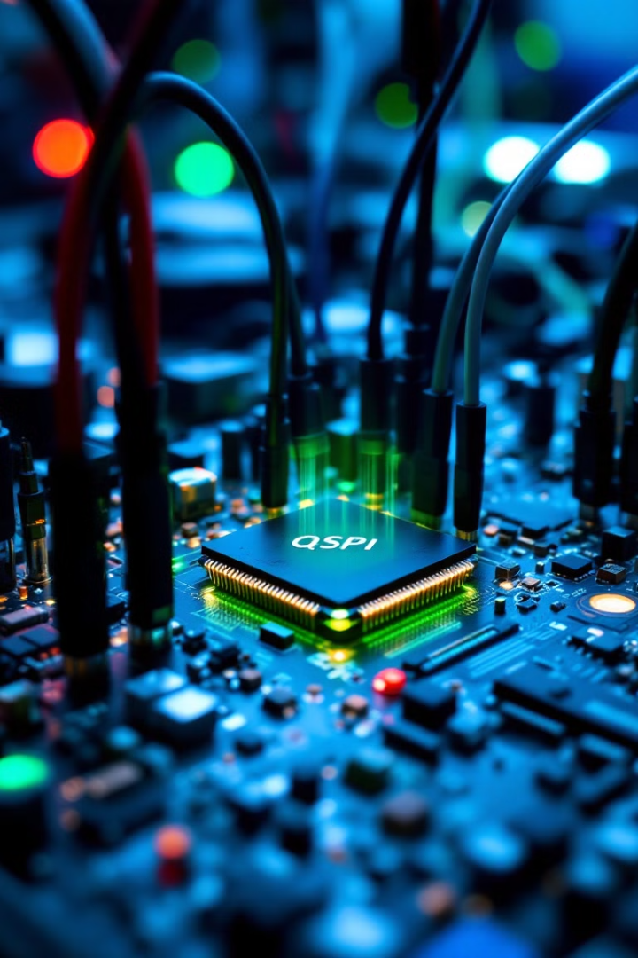
Challenges
Signal Integrity
Complex Configuration
High-speed signals require careful PCB layout (e.g., impedance matching).
Managing command/address/data phases across modes.
Compatibility
Not all SPI masters support Quad modes.

Slide 9
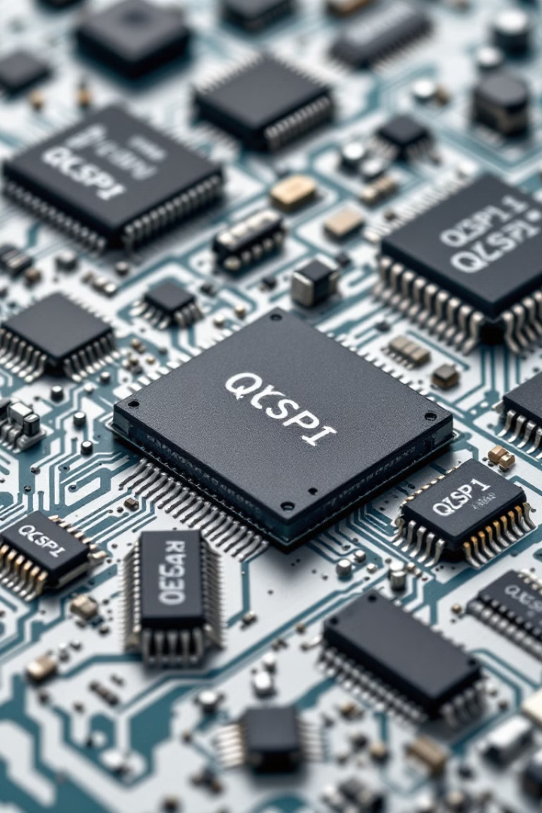
Devices Using QSPI
example devices using the QSPI protocol include external flash memory chips from vendors like Winbond, Macronix, GigaDevice, ISSI, Infineon, and Microchip. Additionally, many modern microcontrollers and SoCs (from Nordic, NXP, Infineon, SiFive, etc.) feature integrated QSPI controllers that interface with these memory chips to provide high-speed, memory-mapped access for booting and executing code.
These devices are widely used in automotive, industrial, consumer, and IoT applications where the combination of high throughput, compact design, and the ability to execute code directly from flash (XIP) are essential.

Slide 10
Summary Table of Communication Protocols
Protocol
Speed
Pin Count
Use Case
Key Advantage
SPI
~50 Mbps
4–6
Sensors, EEPROMs
Simple, widely supported
QSPI
~400 Mbps
6+
Flash memory, XIP execution
High speed, flexible
I2C
~3.4 Mbps
2
Low-speed peripherals
Multi-device support
UART
~3 Mbps
2
Debugging, low-speed comms
Simple, asynchronous
SDIO
~200 Mbps
4–8
SD cards, Wi-Fi modules
High throughput
CAN
~1 Mbps
2
Automotive, industrial
Robust, multi-master
Ethernet
~1 Gbps
4+
Networking
Very high speed, networked

